Slide 1

Collections Framework
Unit III-Chapter No. : 7-Collections Framework

Slide 2

Topic Learning Outcomes
List the various interfaces provided by collection framework
Explain methods defined by list Interface.
Explain methods defined by sorted list
Illustrate the methods defined by Set and Map Interface
School of Computer Science & Engineering

Slide 3

Content
Introduction to Collection Framework, Interfaces and classes
Exploring List Interface
Exploring List and set interface implementation classes
Exploring Map Interface
School of Computer Science & Engineering

Slide 4
Collections: Basics
Define
Goals
Algorithms
Interfaces
  Collection
  List
  Set
  Map
Classes
Examples
School of Computer Science & Engineering

Slide 5
Collections: Define
The Collections Framework is a hierarchy of interfaces and classes to manage group of objects.
  manage
    Create group
    Delete group
    Update group
      Add
      Delete
      Insert
      Sort
      Search
  Algorithms: are another important part of the collection framework, they operate on collections and are defined as static methods within the collection class (sort, search, reverse etc.,). They are available to all collections.
School of Computer Science & Engineering

Slide 6
Collections: Goals
High Performance
  We seldom need to code Collections manually, the implementations for the fundamental Collections are highly efficient (we use most of the predefined collection classes to manage group of objects).
The framework had to allow different types of collections to work in a similar manner.
Extending and/or adapting a collection had to be easy.
  The collection Framework is built upon a set of standard interfaces: Set, List, Map
  And also we can implement our own Collection.
School of Computer Science & Engineering

Slide 7
Collections-Interfaces: Collection
It is at the top of all the collections.
It defines common methods.
Method Name | Description
Boolean add(E obj) | Adds objects to invoking collection, returns true if added, false if it fails.
Boolean addAll(Collection c) | Adds all the elements of c to the invoking collection
Void clear() | Removes all the elements from the invoking collection
Boolean contains(Object obj) | Returns true if the invoking collection contains object, returns false if it does not contain
Int size() | Returns the number of elements held in the invoking collection
Boolean remove(Object obj) | Removes specified object from collection and returns true if it is success else false
Boolean removeAll(Collection c) | Removes all elements of c from the invoking collection
School of Computer Science & Engineering

Slide 8
Collections-Interfaces: List
The List interface extends Collection interface
It stores sequence of elements.
Elements can be inserted/accessed by their position- zero based index
A List may contain duplicate elements
Syntax: interface List <E> // E is the type of objects the list holds.
Method | Description
void add(int index, E obj) | Inserts ‘obj’ into the invoking list at the specified index.
boolean addAll(int index, Collection c) | Inserts ‘c’ into the invoking collection starting from ‘index’
E get(int index) | Returns ‘object (of type E)’ from the invoking collection at the specified index.
Int indexOf(Object obj) | Returns the index from invoking collection for the specific object
E remove(int index) | Removes and returns object on the invoking collection at the specified index.
School of Computer Science & Engineering

Slide 9
Collections-Interface: Set
The Set interface defines a set
Extends Collection.
It does not allow duplicates
The add method returns ‘false’ if an attempt is made to add duplicate elements to set.
It does not define any additional methods of its own (it inherits from collection)
Syntax: interface Set <E>
School of Computer Science & Engineering

Slide 10
Collections-Interface: Map
A ‘map’ is an object that stores associations between ‘key’ and ‘value’.
Both ‘key’ and ‘value’ are objects.
The ‘key’ must be unique but the values may be duplicate
  Rollno unique and name can be duplicate
Some maps can accept null key and null values.
The Map interface maps unique keys to values.
The ‘key’ is an object that you use to retrieve a value at a later time.
Given ‘key’ and ‘value’ we can store the data in ‘map’
School of Computer Science & Engineering

Slide 11
Collections- Classes
AbstractCollection: Implements most of the Collection interface
AbstractList: Extends AbstractCollection and implements List interface
ArrayList: Extends AbstractList and implements dynamic array.
AbstractSet: Extends AbstractCollection and implements most of the Set interface.
HashSet: Extends AbstractSet
LinkedHashSet: Extends HashSet to allow inter-order iterations
TreeSet: Extends AbstractSet. Implements a set sorted in a tree.
School of Computer Science & Engineering

Slide 12
Collections- Classes: ArrayList
Syntax : class ArrayList <E>
ArrayList supports dynamic array, that can grow as needed.
Standard arrays are of fixed length.
ArrayList is variable length array of object references.
Constructors
  ArrayList()
  ArrayList(int capacity)
  ArrayList (Collection <? Extends E> c)
School of Computer Science & Engineering

Slide 13
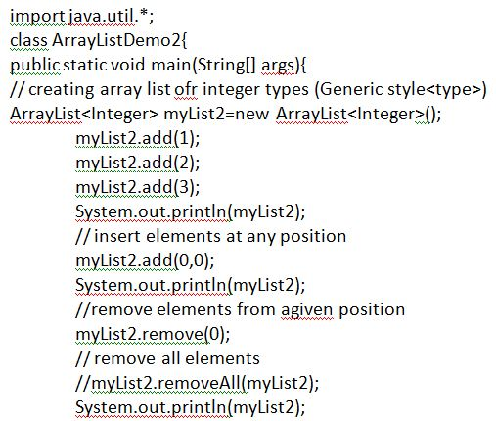
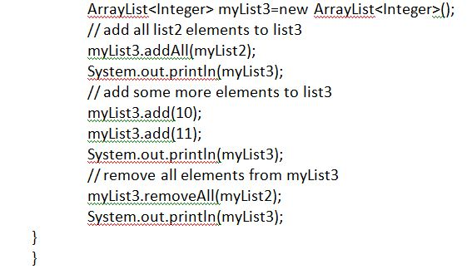
ArrayList Collection: Example
ArrayList to store integer type
School of Computer Science & Engineering

Slide 14
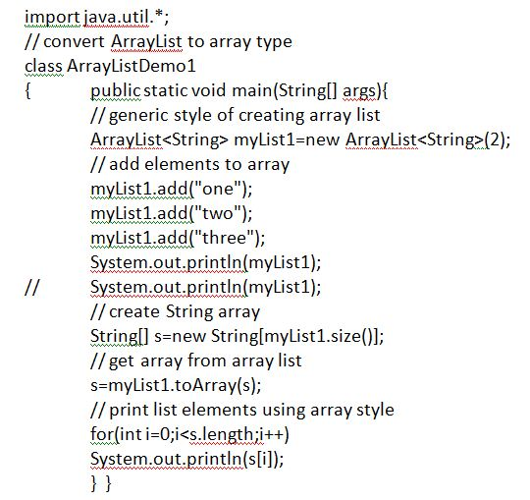
ArrayList: Example
School of Computer Science & Engineering

Slide 15
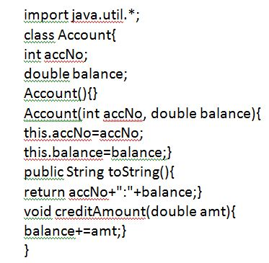
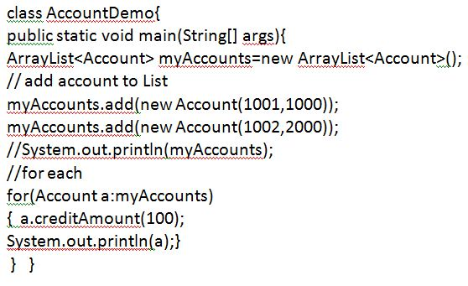
ArrayList: user defined type
School of Computer Science & Engineering

Slide 16
HashSet (Set interface): Example
HashSet extends AbstractSet and implements set interface
HashSet does not define any additional methods beyond those provided by its superclass and interface.
Declaration: class HashSet<E>
Constructors
  HashSet()
  HashSet(Collection <? Extends E> c)
  HashSet(int capacity)
School of Computer Science & Engineering

Slide 17
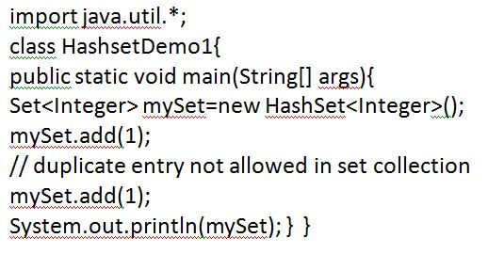
HashSet: Example
School of Computer Science & Engineering

Slide 18
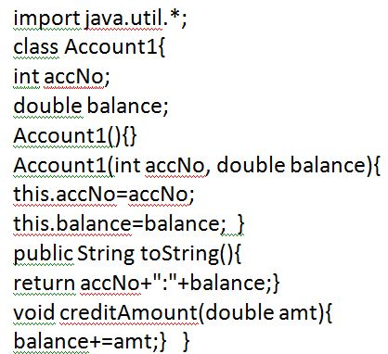
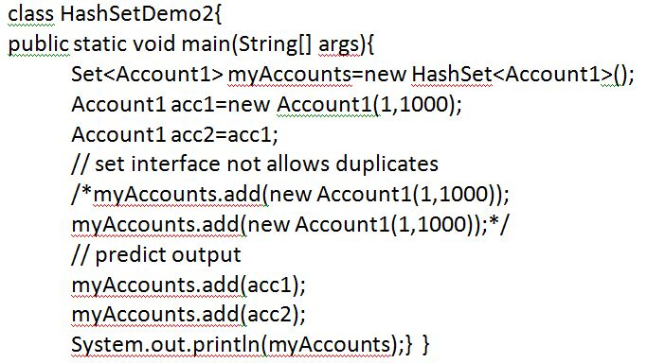
HashSet: Example (User Defined type)
School of Computer Science & Engineering

Slide 19
Map interface
A ‘map’ is an object that stores associations between ‘key’ and ‘value’.
Both ‘key’ and ‘value’ are objects.
The ‘key’ must be unique but the values may be duplicate
  Rollno unique and name can be duplicate
Some maps can accept null key and null values.
The Map interface maps unique keys to values.
The ‘key’ is an object that you use to retrieve a value at a later time.
Given ‘key’ and ‘value’ we can store the data in ‘map’
School of Computer Science & Engineering

Slide 20
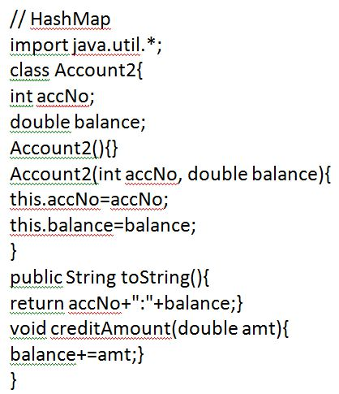
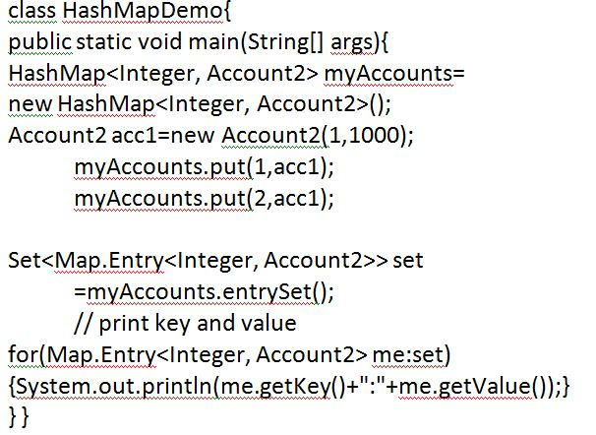
HasMap (Map implementation): Example
School of Computer Science & Engineering

Slide 21
LinkedList
The LinkedList class extends AbstractSequentialList and implements the List, Deque, Queue interfaces.
It provides a linked-list data structure.
Declaration of LinkedList
  class Linkedlist <E> // Here ‘E’ is the type of object the collection holds.
Constructors
  LinkedList()
  LinkedList(Collection<? Extends E> c)
Methods
  addFirst()
  addLast()
  getFirst()
  getLast() , removeFirst() , removeLast()
School of Computer Science & Engineering

Slide 22
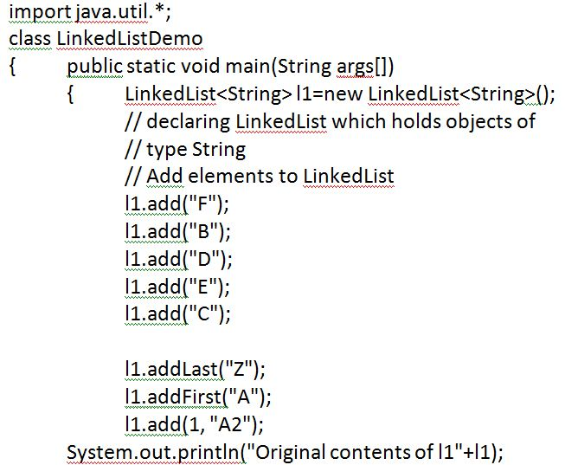
LinkedList: Example
School of Computer Science & Engineering

Slide 23
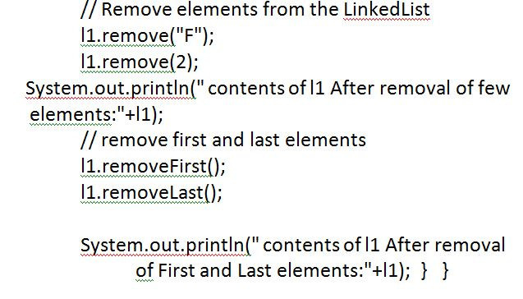
LinkedList: Example
School of Computer Science & Engineering

